Slide 1
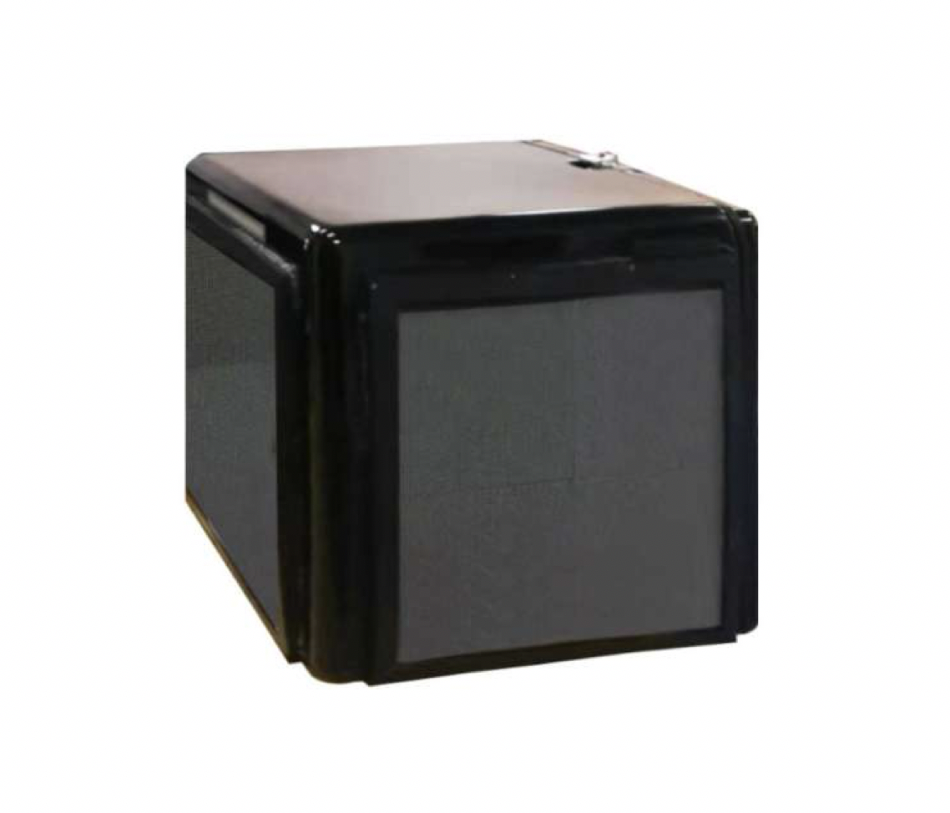
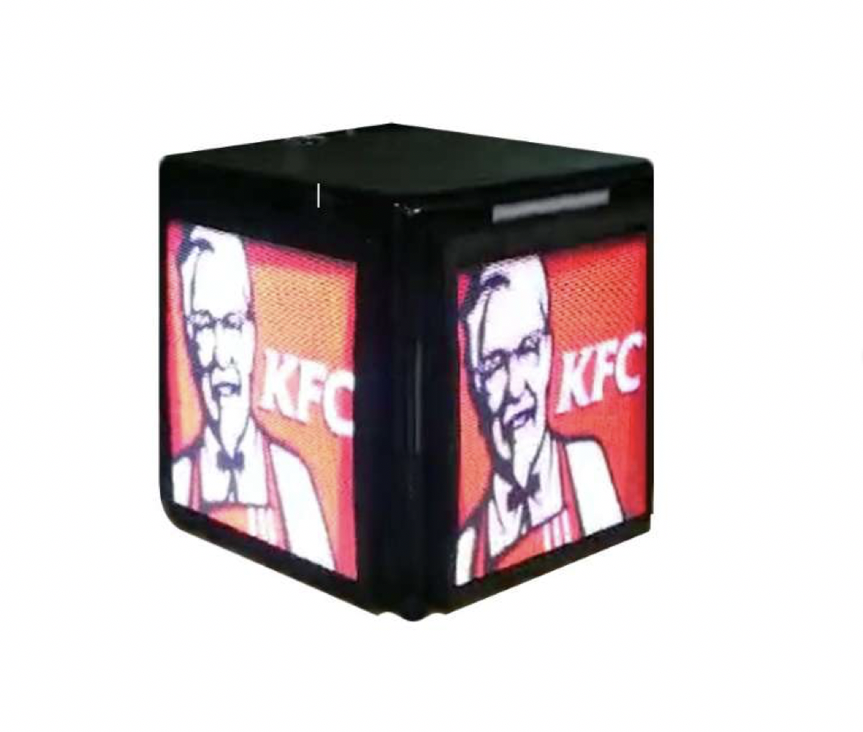
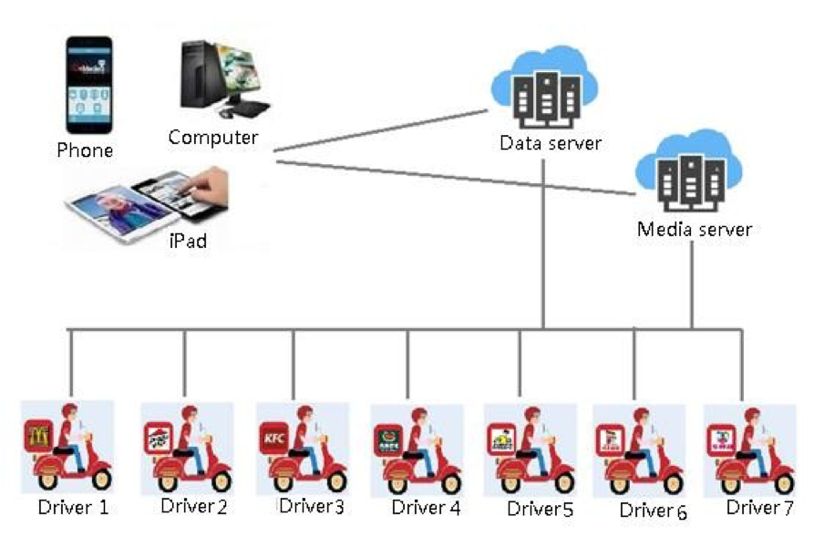
LED Screen
DDB
P3mm Digital Delivery Box | Creative LED Display
♦FEATURES
►Creative design
Digital delivery box with three-side LED display on it, showing advertising when delivery man drive motorcycle to the client.
►Count Function
Calculate how many audience all the way.
►Compatibility
Intergrate with your current delivery system.
►Plug and Play
Connect with your motorcycle battery
►Location Free for Advertising
A new and efficient way to showing advertisement anywhere.
♦Application Reference

Slide 2
Parameters
LED Screen
Pixel Pitch |  | P3.0mm
Screen | LED Type | SMD1415
 | Pixel Density(dot/m2) | 110,889
 | Module Size | 192 x 192mm
 | Screen Size (each side) | 384 x 384mm
 | Screen Resolution (each side) | 128 x 128
 | Box Size(mm) | 500 W x 500 H x 500 D mm
 | Max. Power Consumption(w/sets) | 350
 | Ave. Power Consumption(w/sets) | 200
 | Operating System | Android System
 | Weight | 17KG
 | Grey Level | 14bit
 | Driving Voltage(V) | 5
 | Input(V) | 110-220
 | Brightness | >4,500
 | Viewing Angle | 140 ° /140°
 | Ingress Protection | IP65
 | Refresh Frequency | 1920-3840Hz
 | Operating Temperature | -20℃+60℃
 | Operating Humidity | 10%-90% RH

