Slide 1
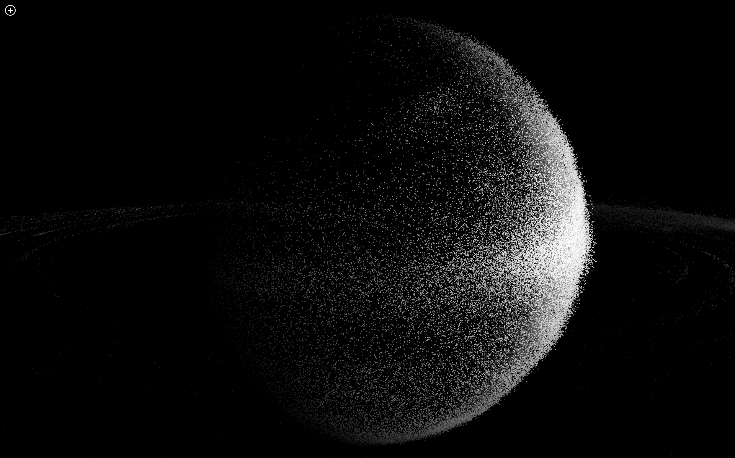
Holographic LED Screen
Make it happen

Slide 2
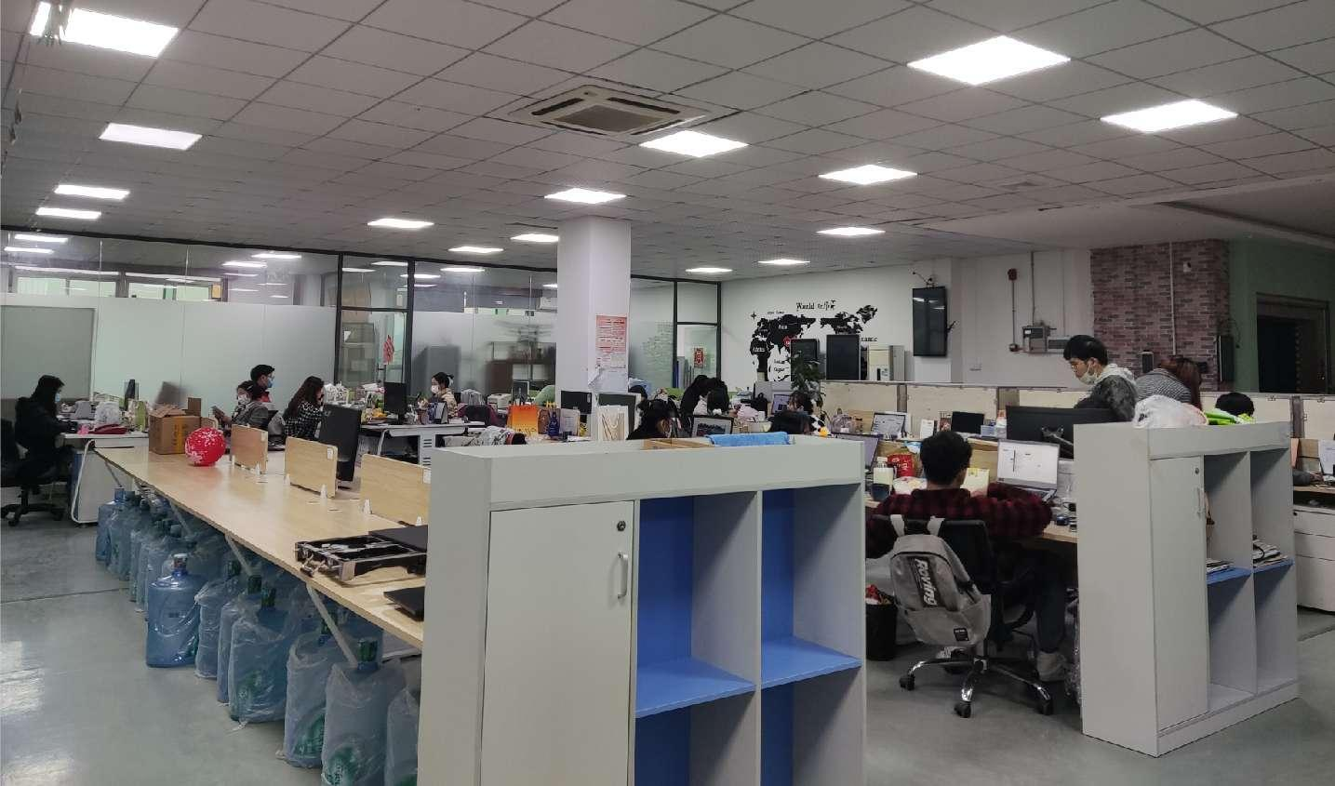
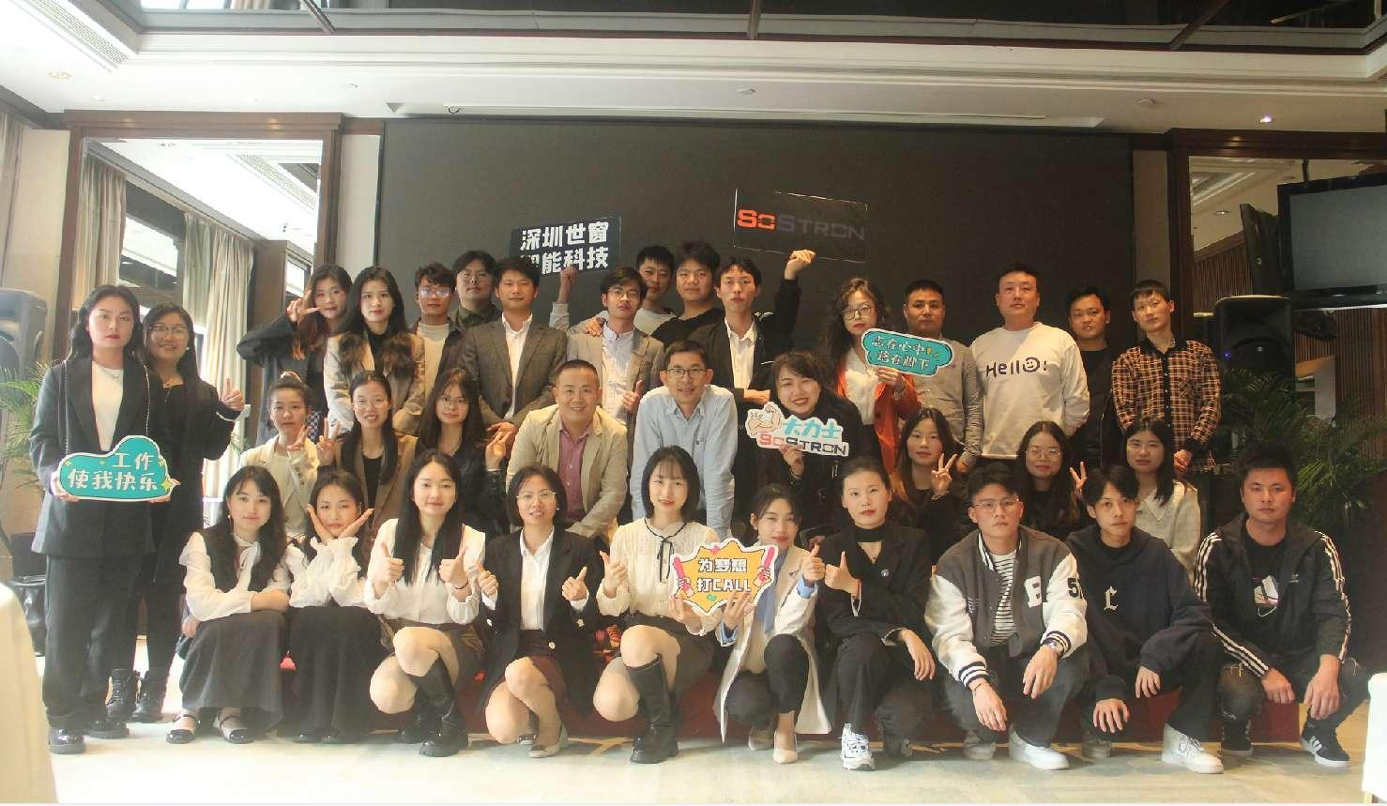
Shenzhen SoStron Technology Co.,LTD is a Hi-tech company which specialized in hardware like LED, LCD Display and pixel lights and advertising control related software. we have a team whose experience is more than 12 years in this industry.
Based in Shenzhen, China, SoStron has a 2500sqm factory, a 300sqm office, and our own R&D software and hardware team. Currently SoStron products have been widely used for outdoor advertising, TV station, conference, exhibitions, banking, telecommunications, retails, concerts and events, etc. So far our products are exported world-widely to more than 70 countries from the .
SoStron is dedicated to provide perfect products and excellent service for our clients. We want to cooperate with you as our partner, highly welcome to join us, work together and win together!

Slide 3
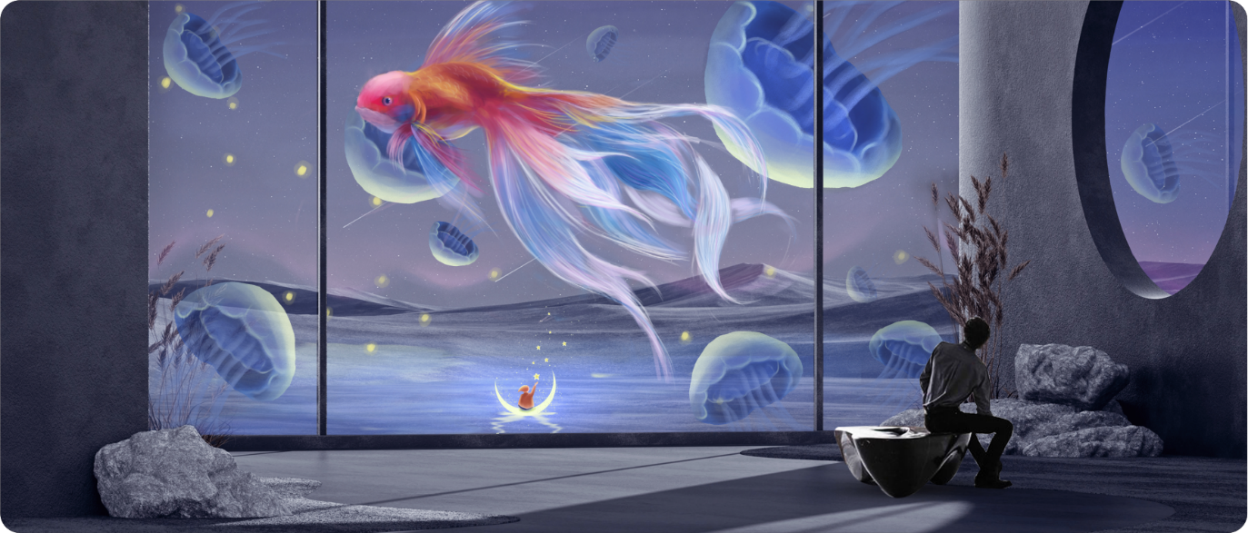
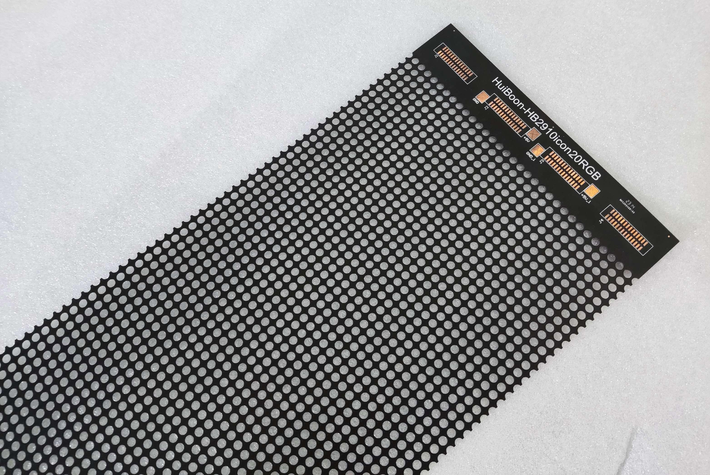
Holographic LED Screen
LED transparent screen belongs to a subdivision of LED screen, accounting for about 5% of the LED screen market. At present, there are transparent products such as grille screen, film screen (crystal film screen), photoelectric glass screen on the market. At present, these products may affect the transparency due to the structure (there is a keel structure in the middle of the screen), the display effect is not clear enough (insufficient brightness, large pixel spacing, horizontal or vertical cutting, etc.), and after-sales maintenance is troublesome (dead pixels affect the entire module , after-sales maintenance requires modules to be returned to the factory, etc.) and other functional and structural issues, cannot be fully accepted by end consumers, and cannot expand market share. After several years of research and development, SOSRTON has completely solved the above problems of the existing transparent screen from the core technology of the chip to the appearance and structure of the product, and truly achieved the coexistence of display and transparency. The display is completely transparent, without any keels. In terms of playback content, transparent videos, ordinary videos, holographic videos and naked-eye 3D videos can all be seamlessly connected. Products are widely used in commercial window, commercial curtain wall, exhibition hall, creative display, entertainment and tourism, automobile 4S shop and other fields.
conents

Slide 4
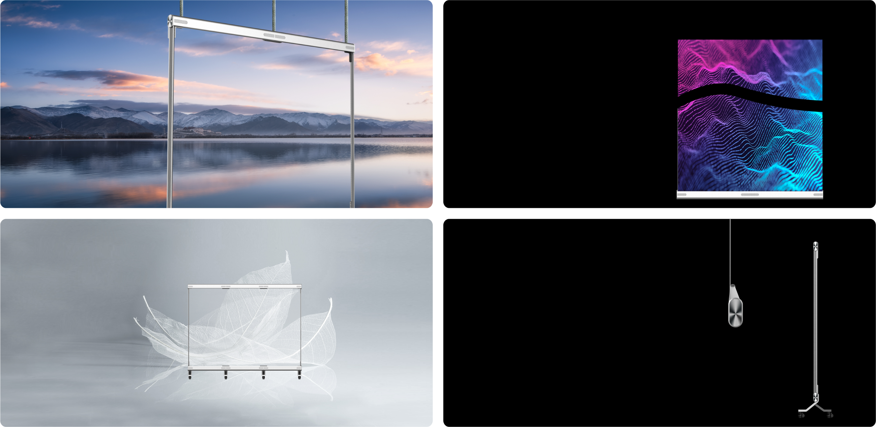
Holographic LED Screen Features
Transparent
Flexible
It's a game-changer in the industry, without structural skeleton in the middle of the screen, which provides high visual transparency at 90% when glued onto a glass wall.
Standard modules can be bent, cut, and used flexibly.
The best partner for curved glass and special-shaped screen.
Light
Thin
Professional aesthetic design, thin and beautiful.
Display body products. The weight is only 6KG/square meter.
Screen thickness is less than 2MM, which can be seamless surface mount. Mounted on transparent glass.

Slide 5
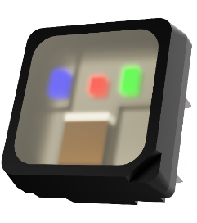
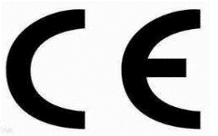
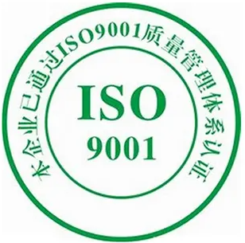
Holographic LED Screen Features
Independent research and development of driver IC, 16 bit gray level, high refresh rate. Independent core technology, any dead pixel does not affect other lamp beads. Easy maintenance, no need to return to the factory, simple training can be used for maintenance.
Built-in design, integrated lamp driver, single point and single control, each LED lamp bead is a "power source". Make the control more precise and the heat dissipation more uniform. Micron-scale light-emitting source, with excellent performance such as transparency, high temperature resistance, moisture resistance, and low power consumption.
With independent intellectual property rights, dozens of patents have been authorized. The products meet the requirements of domestic and foreign industry standards, and have obtained various certifications such as CCC, CE, FCC, ROHS, and flame retardant testing.
BS476: Part7: 1997

Slide 6
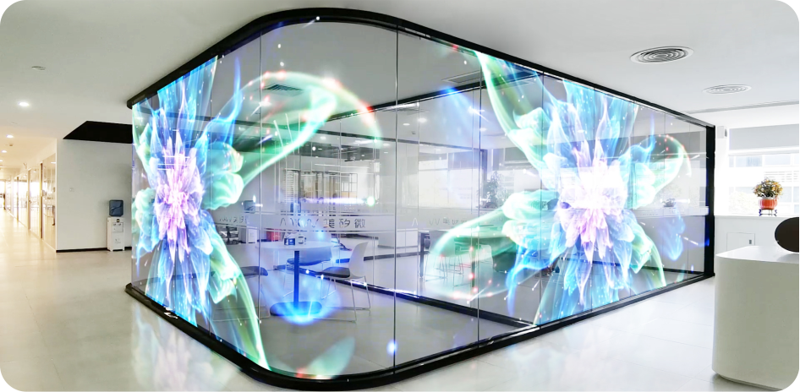
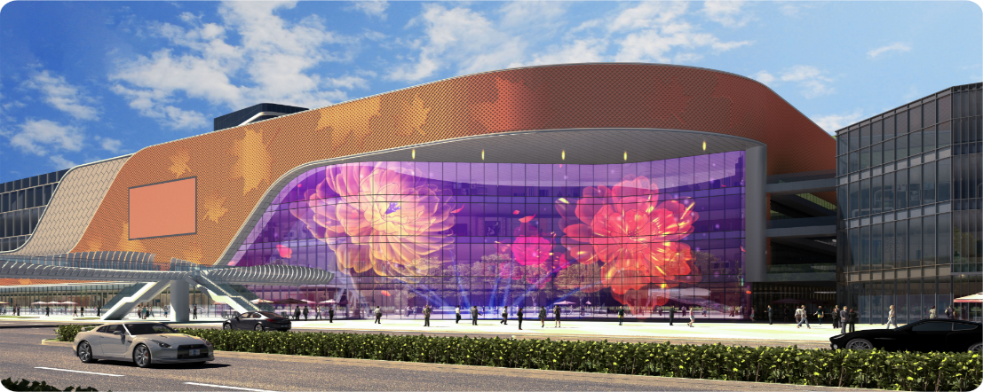
Holographic LED Screen Application
Glue on Glass
Ultra-clear and ultra-thin, high-transparency and high-temperature resistant high-end materials are used. The light board is perfectly designed to easily achieve a permeability of up to 80%. The overall mounting without a structural skeleton, the screen body can be spliced left and right, up and down, and can achieve a display height or width of 2.4-3 meters. Commercial window, glass curtain wall and other indoor and outdoor scenes.

Slide 7
Holographic LED Screen Specs
Model | M3 | M6
Size(m) | 1*2 | 2*2
Pixel Pitch (mm) | P3.91/P3.91 | P6.25/P6.25
Visual Transparency | 80% | 90%
Pixel Density (dot / m²) | 65536 | 25600
Cabinet Size (mm) | 1000x250 \ 1200x250 | 1500x250
Cabinet Resolution（dot） | 256x64 \ 300X64 | 240X40
Weight (Kg / ㎡) | 6 | 5
Brightness (cd/ m²) | ≥ 4000 | ≥ 5000
Package Form | Light driver integrated package
Scan Mode | Single point single control, static drive
LED Lifespan | ≥ 100,000.00 hours
Grayscale | 65536
Maximum Power Consumption (w / m²) | 800
Average Power Consumption (w / m²) | 200
LED Controller | Synchronous/Asynchronous
Input Current | AC100~240V 50/60 Hz
Module Working Current | DC 4.2V ± 0.2V

Slide 8
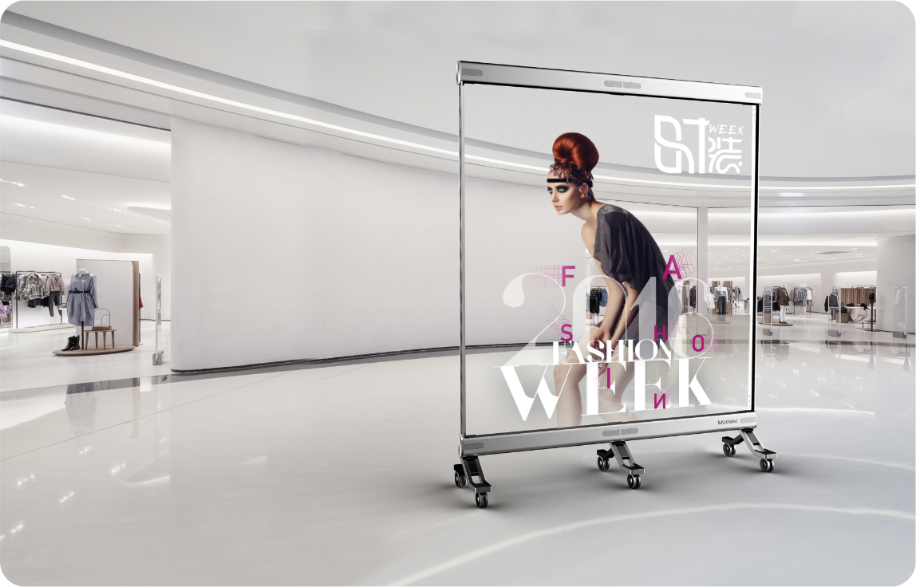
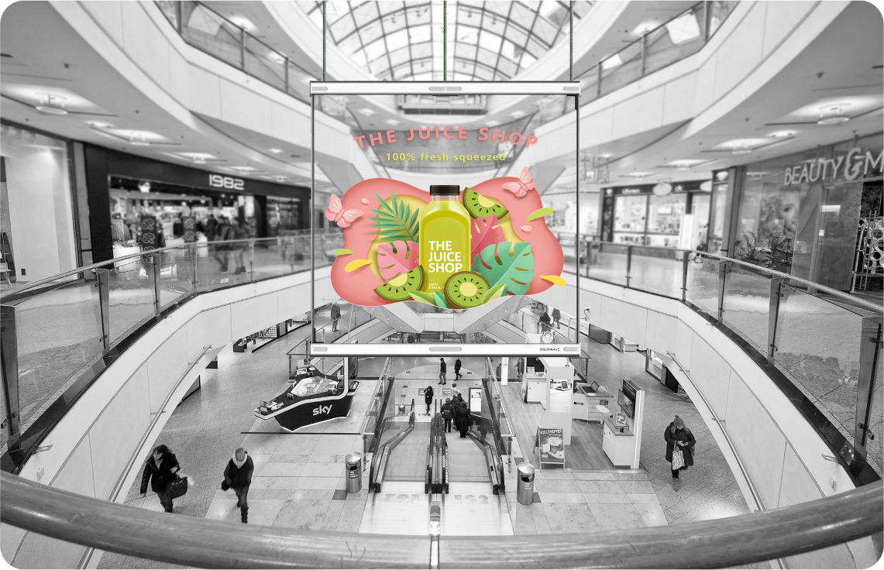
Holographic LED Screen Application
Free-standing
Hanging
SOSTRON also have another design for LED poster, which is movable and detachable. Display modules can be increased or decreased at any time according to the usage environment like exhibition booth, stage and other scenarios.
The product is lightweight and easy to install for stage performance, door curtains show and other advertising scenes.

Slide 9
Holographic LED Screen Specs
Item | M3 | M6
Size(mm) | 1000*2000 | 2000*2000
Pixel Pitch (mm) | Horizontal: 3.91, Vertical: 3.91 | Horizontal: 6.25, Vertical: 6.25
Pixel Density (dot/ m²) | 65536 | 25600
Profile Dimension (mm) | 1021x2452*500 | 2021x2452*500
Dipslay Dimension(mm) | 1000*2000 | 2000*2000
Resolution（dot） | 256x512 | 320x320
Weight (Kg/SET) | 37 | 58
Brightness(cd/ m²) | 4000
Encapsulation Type | Combo Design
Scanning | Static
Lifespan | ≥ 100,000.00 hours
Pixel Configuration | RGB 3-In-1
Grey Scale | 65536（16bit）
Average Power Consumption (W/ m²) | 280
Maximum Power Consumption (W/ m²) | 800
Control System | Colorlight
Connection Type | Supporting WiFi / DVI / HDMI / DP / USB / RJ45 / Network Remote Control（Based on the controller model）
Input Voltage | AC100~240V 50/60Hz
Working Voltage for Module | DC4.7~5V ±0.2V
Cabinet Material | Aviation Aluminum Alloy
Maintenance Way | Front
Installation Environment | Indoor
Working Temperature & Humidity | Temperature: -10~40℃ Humidity: 10%-90% (Without condensation)
Installation Way | Mobile Bracket

Slide 10
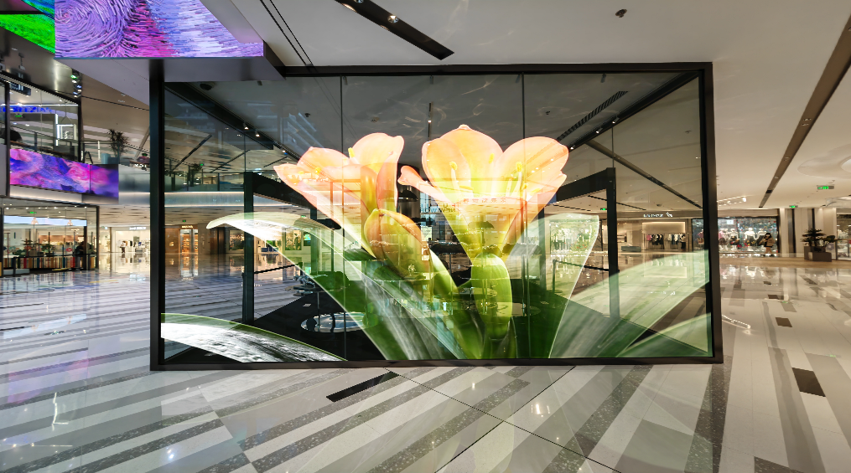
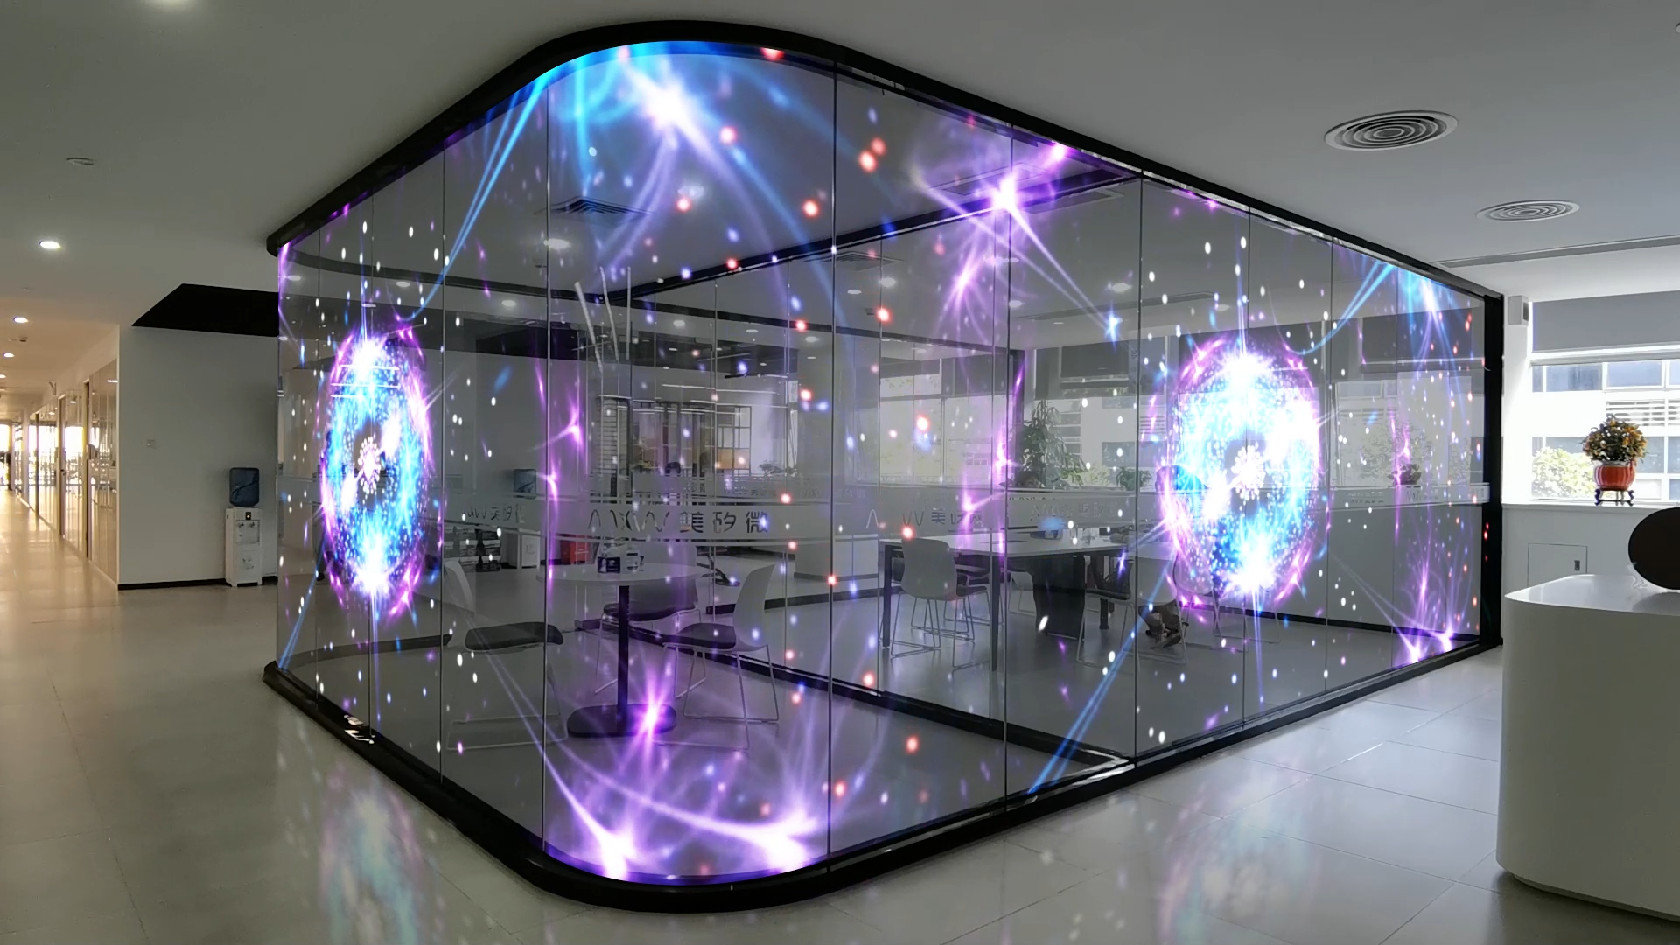
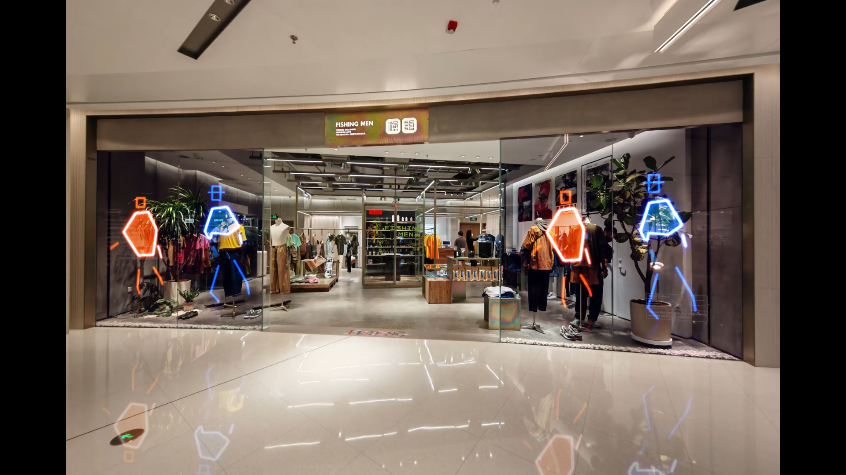
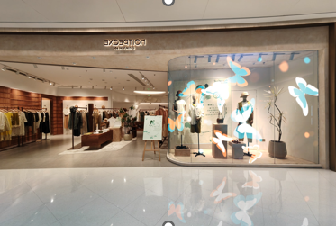
Applications
Widely used in creative display, comprehensive shopping malls, retail window, exhibition display and other scenes.

Slide 11
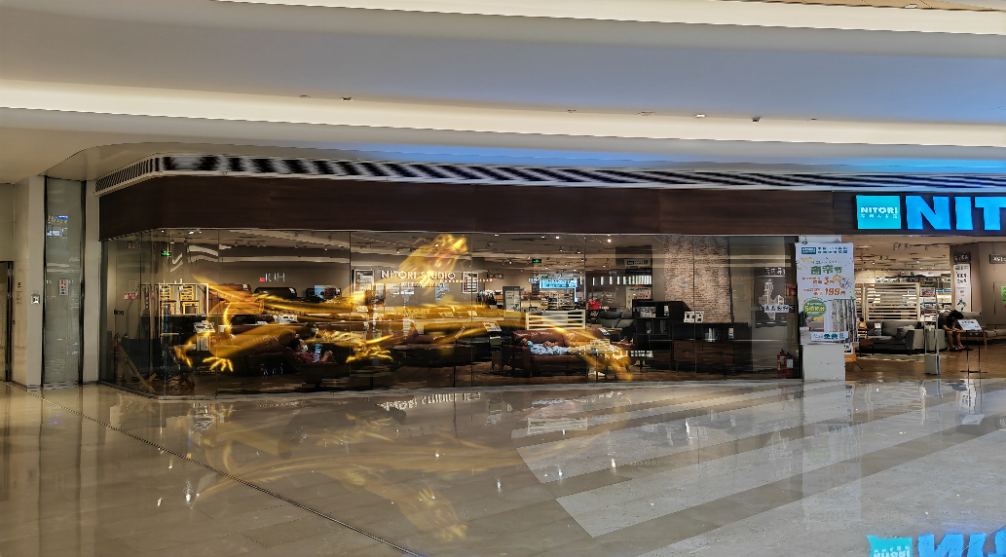
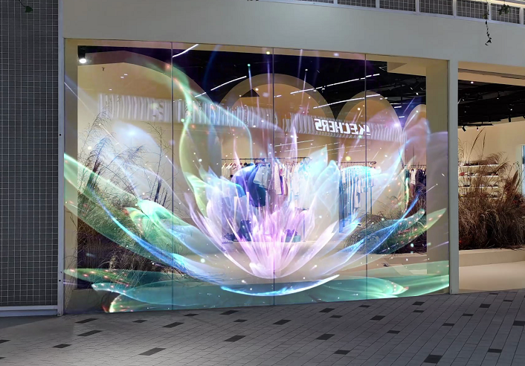
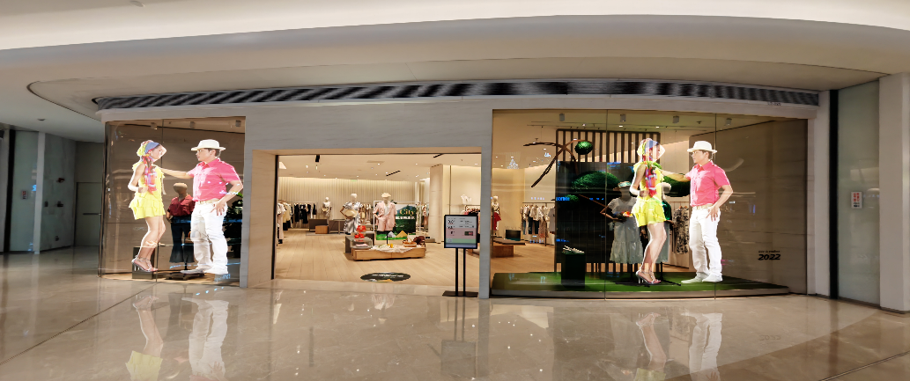
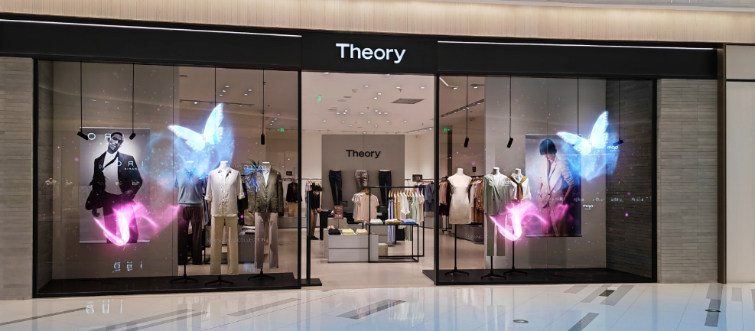
Applications
Widely used in creative display, comprehensive shopping malls, retail window, exhibition display and other scenes.

Slide 12
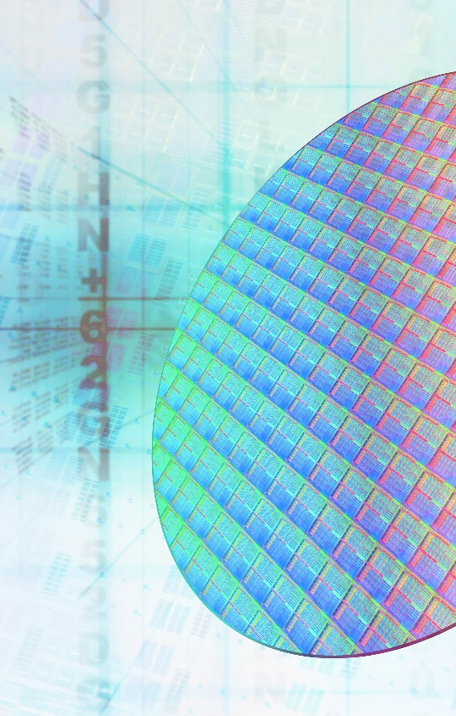
Company Culture
Our Vision
Become the most reliable display service provider in the hearts of customers
Our Mission
To better display goods and services for customers and create a happy life for employees
Innovation
Cooperation
Responsibility
Grateful

Slide 13
CONTACT US
Address
4th floor, Building D, SanMin industrial park, Shilongzai, Shiyan town, Baoan district, Shenzhen, China
Website
www.sostron.com
Tel.
+86 755 2107 6824
Em ia l
info@sostron.com
Com pany
SHENZHEN SOSTRON TECHNOLOGY CO., LTD

