Slide 1
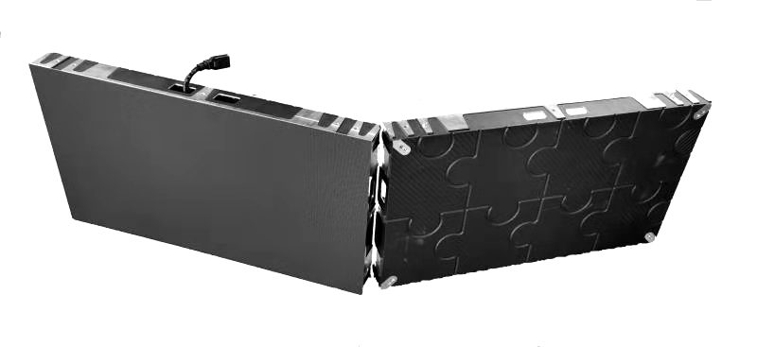
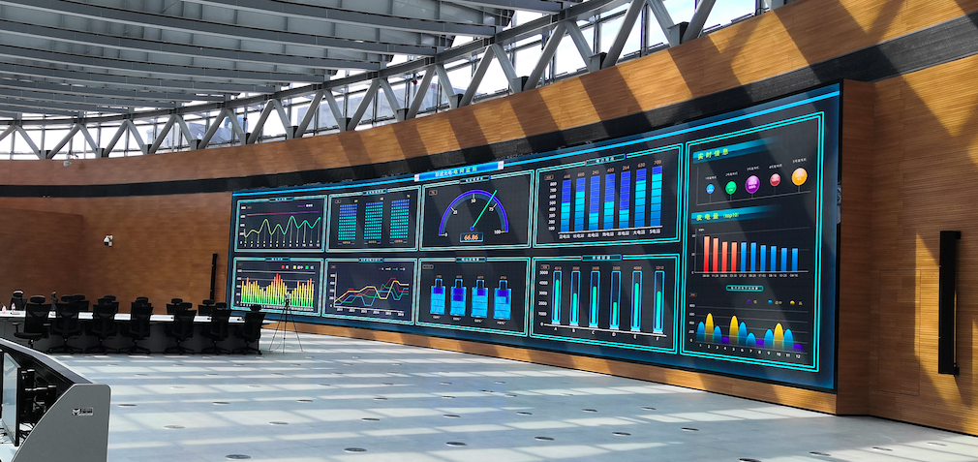
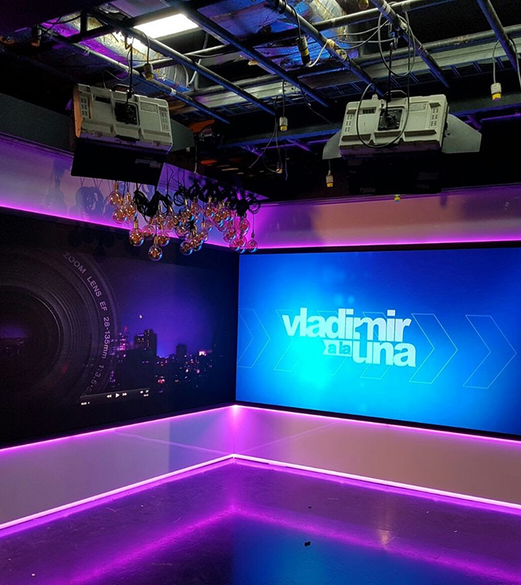
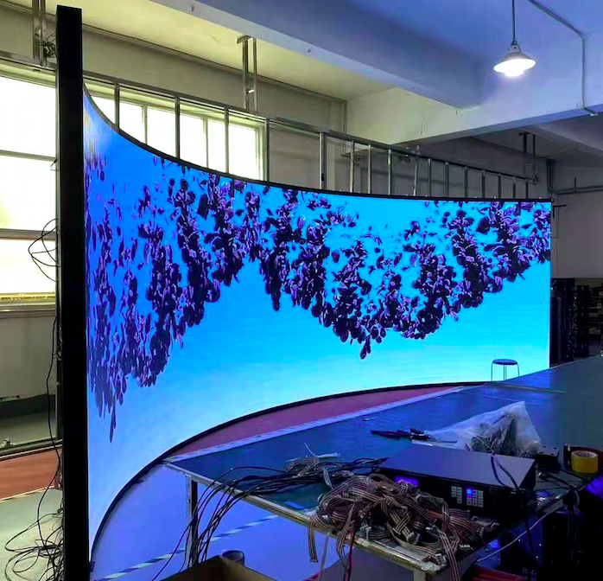
HiLux Series Indoor Fine Pitch Solutions
Applications
Monitoring center
TV Studio
Conference
Monitoring center

Slide 2
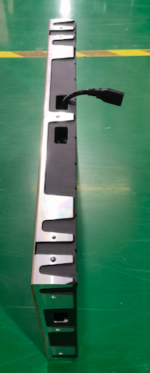
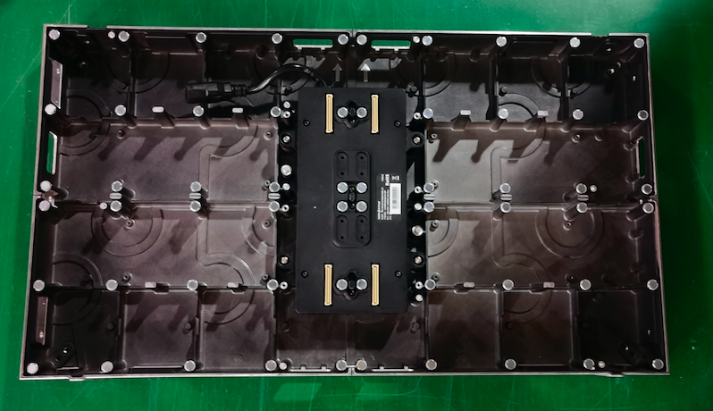
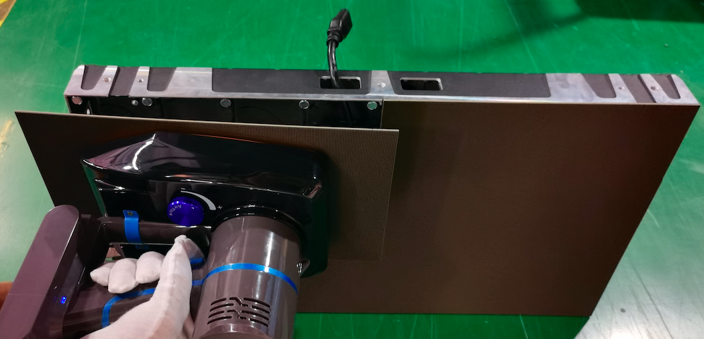
Design and Maintenance
Slim
5.6KG/Panel
D:58mm
CNC
Die-casting aluminum panel
with CNC machining
Fast
Easy installation and
maintenance
Clear
NO cable inside
All connectors

Slide 3
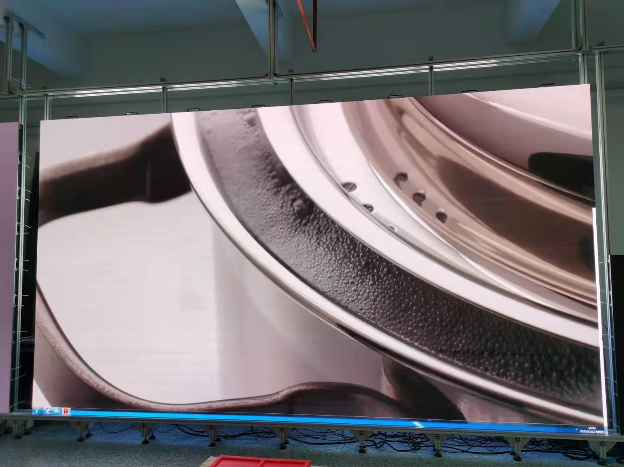
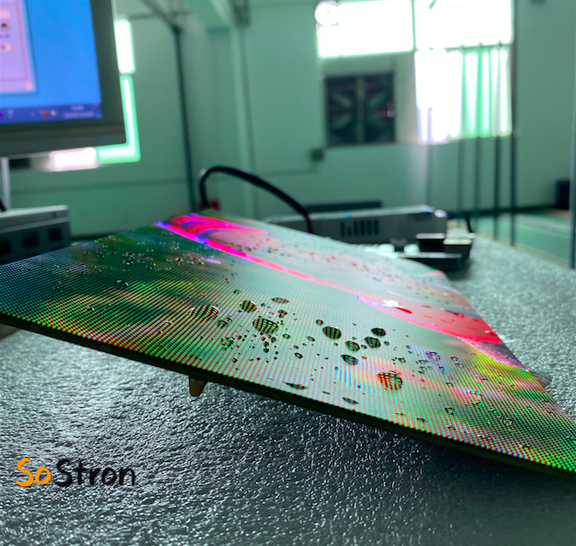
Performance
Ratio 16:9
Size: 600x337.50mm
HD
High contrast
Modulize
All cabinets share the same module
GOB optional
Waterproof
Anti-crash

Slide 4
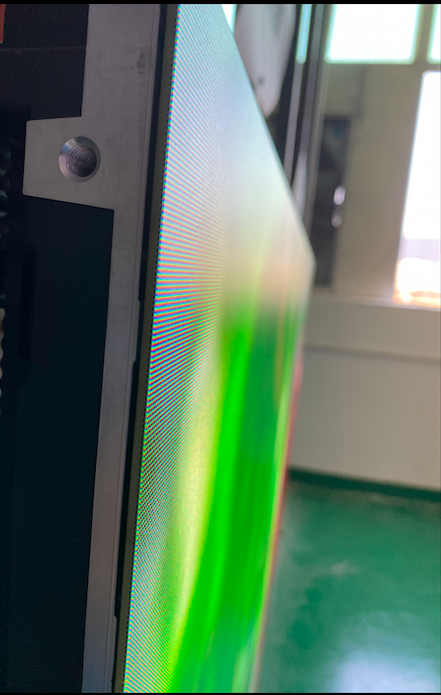
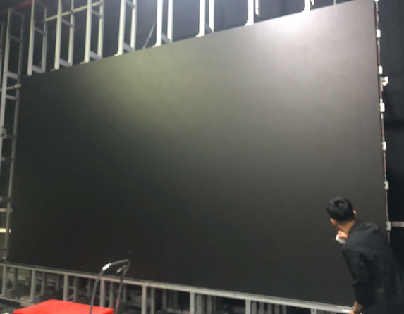
Installation- flatness

Slide 5
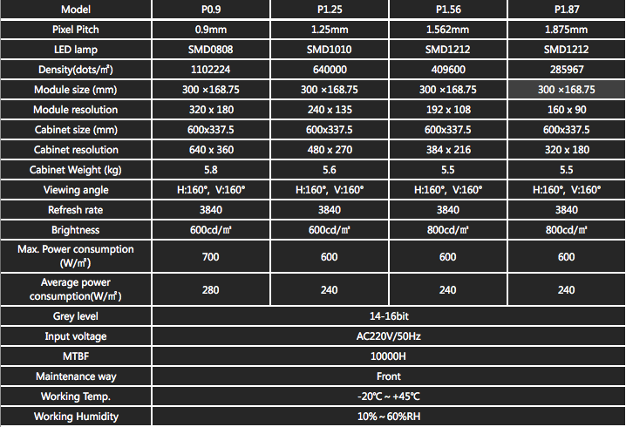
Technical Specifications

